Slide 1
Steps to Run the Website

Slide 2
Step 1: Open Google Colab and upload GenText.ipynb.
Step 2: Install required packages and run all the cells.

Slide 3
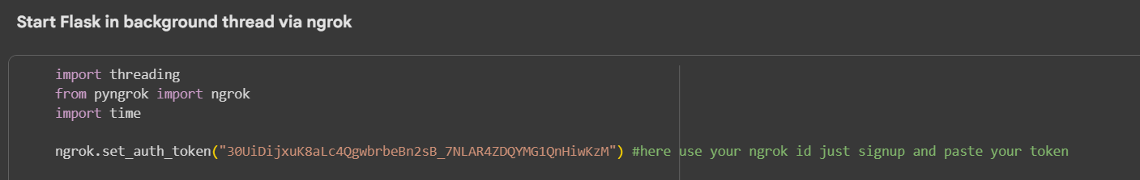
Step 3:In cell 5, replace the token with your ID token. (If the current token is valid and running, you can skip this step.)
Note: You can use the service up to 3 times. After that, you need to terminate (kill) the terminal/session before starting again.

Slide 4
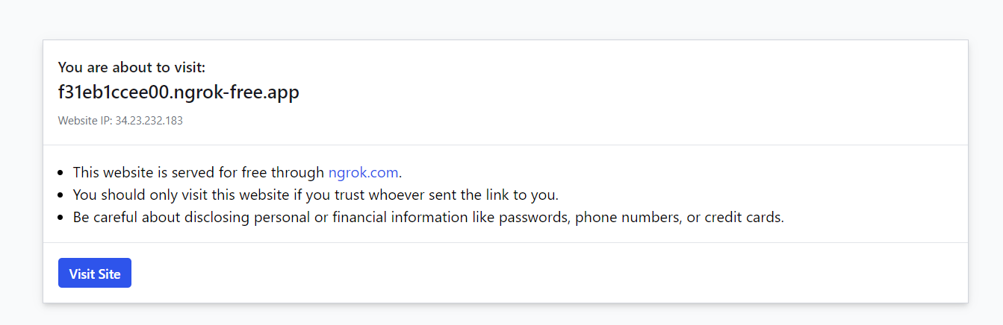
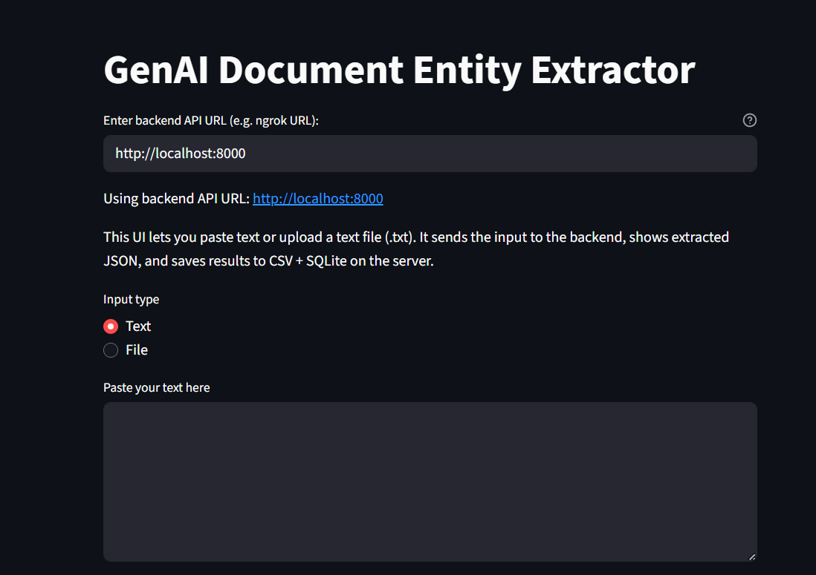
Step 4:Run cells 6 and 7. You will get a link click on it to visit the page.
Step 5:Explore and interact with the website that opens.

